Slide 1


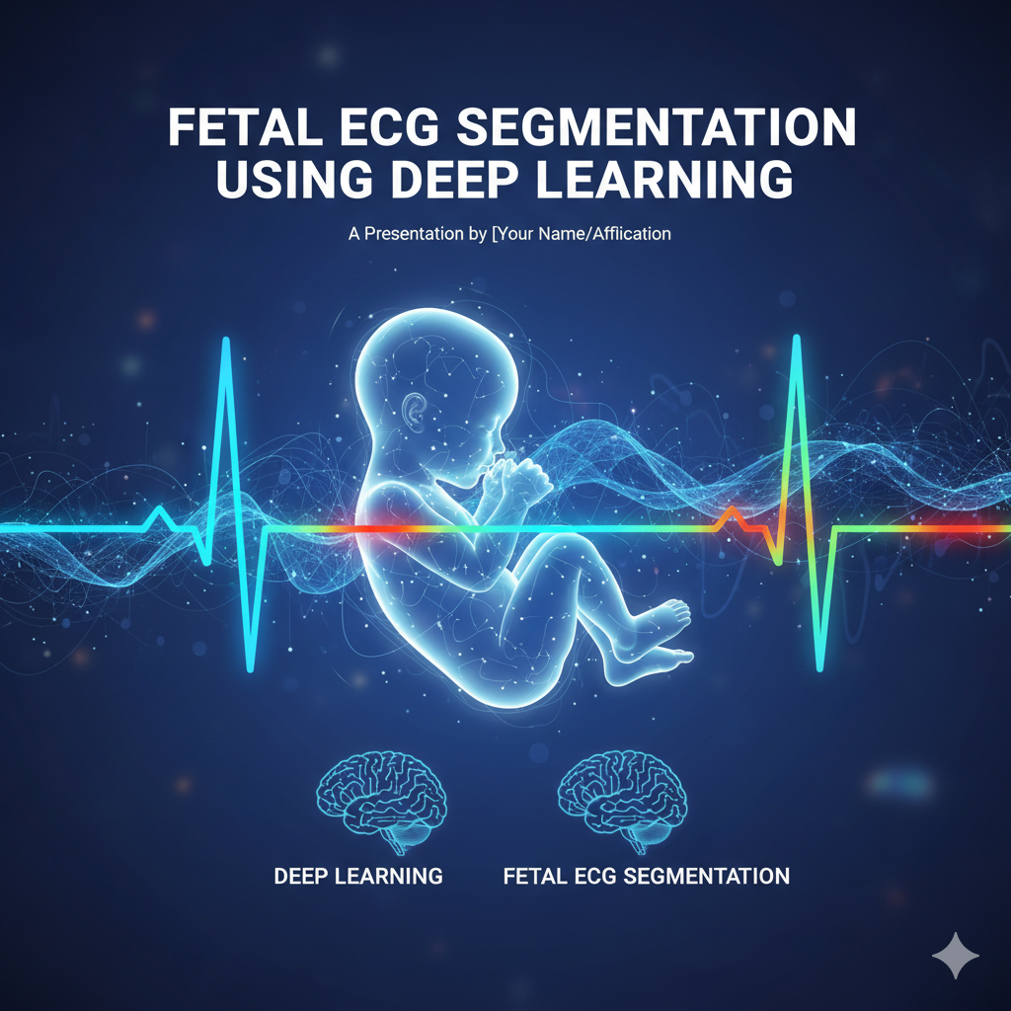
MINOR PROJECT SECOND DEFENSE
FETAL ECG SEGMENTATION USING DEEP LEARNING
Efforts by:
UDAY BANSAL (35220802822)
HARSHITA SHARMA (21020802822)
ALVIN K SIJO (02120802822)
KANAK PANDEY (20320802822)
DEPARTMENT OF ELECTRONICS AND COMMUNICATION ENGINEERING, BHAGWAN PARSHURAM INSTITUTE OF TECHNOLOGY

Slide 2
WHY THIS PROJECT TOPIC?
FETAL ECG MONITORING PROVIDES CRUCIAL INFORMATION ABOUT THE BABY'S HEART HEALTH, ENABLING EARLY DETECTION OF CONGENITAL HEART CONDITIONS AND DISTRESS.​
THERE IS A GROWING NEED FOR NON-INVASIVE, ACCESSIBLE, AND ACCURATE FETAL MONITORING TO IMPROVE PRENATAL OUTCOMES FOR MOTHERS AND INFANTS.​
TRADITIONAL FETAL MONITORING SOLUTIONS OFTEN LACK SENSITIVITY AND MAY NOT PROVIDE DETAILED FETAL HEART WAVEFORMS NEEDED FOR ADVANCED DIAGNOSIS.​
BY USING DEEP LEARNING, THIS PROJECT TARGETS MORE ACCURATE SEPARATION OF FETAL ECG FROM MATERNAL AND NOISY BACKGROUNDS, IMPROVING CLINICAL RELIABILITY.​
THE PROJECT SUPPORTS THE FUTURE OF PERSONALIZED, TECHNOLOGY-DRIVEN MATERNAL HEALTHCARE.
LIMITATIONS OF TRADITIONAL MONITORING
MOST EXISTING METHODS ARE EITHER INVASIVE (FETAL SCALP ELECTRODE) OR OFFER ONLY INDIRECT/AGGREGATE HEART RATE INFORMATION, NOT FULL ECG WAVEFORMS.​
SIGNAL QUALITY IS OFTEN POOR DUE TO INTERFERENCE FROM MATERNAL ECG AND MOTION, MAKING ACCURATE FETAL ASSESSMENT DIFFICULT.​
MANY SYSTEMS FAIL TO PROVIDE SUFFICIENT DETAIL FOR DETECTING SUBTLE RHYTHM OR WAVEFORM ABNORMALITIES.​
COMPLEXITY AND DISCOMFORT OF TRADITIONAL TECHNIQUES LIMIT THEIR USABILITY FOR REGULAR HOME- OR MOBILE-BASED MONITORING.
​
DEPARTMENT OF ELECTRONICS AND COMMUNICATION ENGINEERING, BHAGWAN PARSHURAM INSTITUTE OF TECHNOLOGY

Slide 3
​
NEED FOR REAL-TIME AND CONTINUOUS MONITORING
MODERN PRENATAL CARE REQUIRES IMMEDIATE DETECTION OF CHANGES IN FETAL CONDITION TO PREVENT ADVERSE OUTCOMES.​
CONTINUOUS, REAL-TIME MONITORING ALLOWS FOR EFFECTIVE INTERVENTION DURING SUDDEN EPISODES OF FETAL DISTRESS OR HYPOXIA.​
HOME-BASED AND REMOTE HEALTHCARE SETTINGS BENEFIT FROM REAL-TIME ALERTS, ENSURING SAFETY OUTSIDE HOSPITALS.​
CONTINUOUS DATA ENABLES TRACKING FETAL DEVELOPMENT TRENDS, NOT JUST SINGLE-TIME EVENTS.
REAL-TIME INSIGHT BUILDS CONFIDENCE FOR MOTHERS AND CLINICIANS THROUGH PROACTIVE CARE.
PROBLEM STATEMENT
CURRENT FETAL ECG MONITORING IS OFTEN INSUFFICIENT FOR EARLY, ACCURATE, AND COMPREHENSIVE DETECTION OF FETAL HEART ISSUES.​
EXTRACTING FETAL ECG SIGNALS IS CHALLENGING DUE TO OVERLAPPING MATERNAL ECG AND NOISE, ESPECIALLY IN NON-CLINICAL SETTINGS.​
THERE IS A CLEAR CLINICAL NEED FOR A ROBUST, REAL-TIME FETAL ECG SOLUTION THAT WORKS NON-INVASIVELY AND CONTINUOUSLY.​
LIMITATIONS OF TRADITIONAL AND EXISTING DIGITAL SOLUTIONS RESULT IN MISSED OR LATE DETECTIONS OF CRITICAL CONDITIONS.
THIS PROJECT AIMS TO DELIVER A PRACTICAL, HIGH-FIDELITY APPROACH TO FETAL ECG MONITORING THAT CAN BE WIDELY ADOPTED
DEPARTMENT OF ELECTRONICS AND COMMUNICATION ENGINEERING, BHAGWAN PARSHURAM INSTITUTE OF TECHNOLOGY

Slide 4
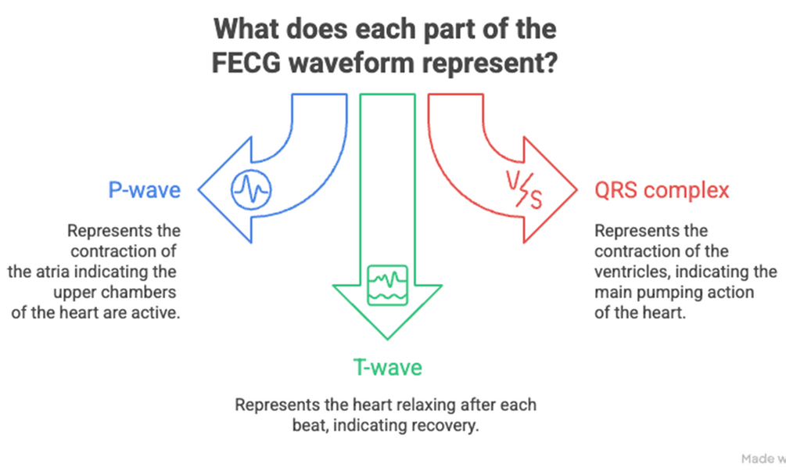
INTRODUCTION
WHAT IS FECG WAVEFORM ?
Fetal ECG (FECG) is used to record the baby’s heartbeat from the mother in a safe, non-invasive way. The baby’s signal is very weak and gets mixed with the mother’s heartbeat and outside noise, so it needs to be cleaned and processed.
FECG waveform shows the electrical activity of the baby’s heart inside the womb. Just like a normal ECG, it has three main parts:
•P-wave → shows the upper chambers of the heart (atria) contracting.
•QRS complex → shows the main pumping action of the heart (ventricles contracting).
•T-wave → shows the heart relaxing after each beat.
DEPARTMENT OF ELECTRONICS AND COMMUNICATION ENGINEERING, BHAGWAN PARSHURAM INSTITUTE OF TECHNOLOGY

Slide 5
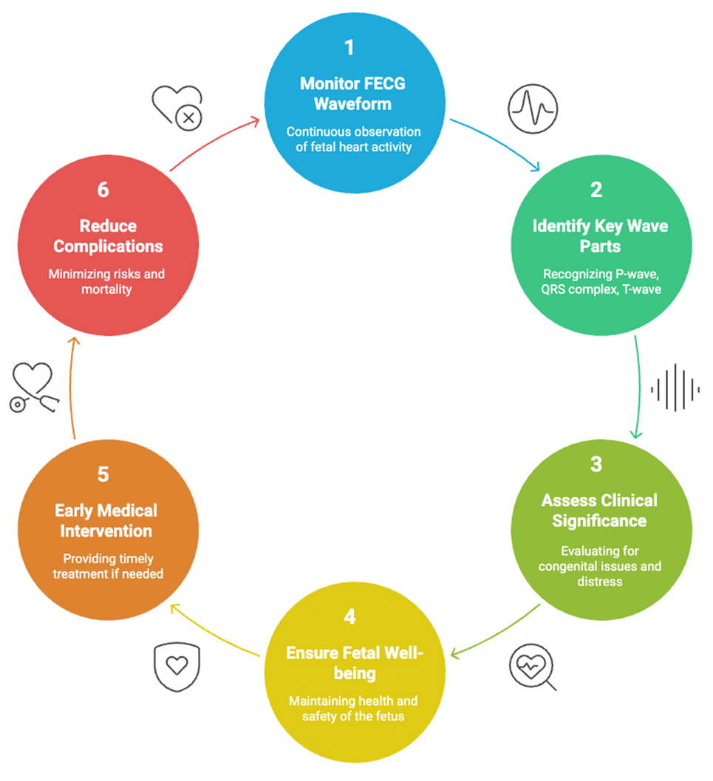

CLINICAL SIGNIFICANCE OF FECG
FECG gives doctors important information about the baby’s heart during pregnancy. It helps in detecting heart defects early, checking if the baby is under stress, and ensuring that the heart is developing normally. This makes it a very useful tool for safer pregnancies and better newborn health.
IMPORTANCE OF CONTINUOUS MONITORING
Continuous fetal ECG monitoring allows doctors to keep track of the baby’s heart in real time. It helps in spotting sudden changes, warning signs of distress, or irregular heartbeats. With early detection, doctors can act quickly, which reduces risks for both the mother and the baby and supports a safer delivery.
DEPARTMENT OF ELECTRONICS AND COMMUNICATION ENGINEERING, BHAGWAN PARSHURAM INSTITUTE OF TECHNOLOGY

Slide 6
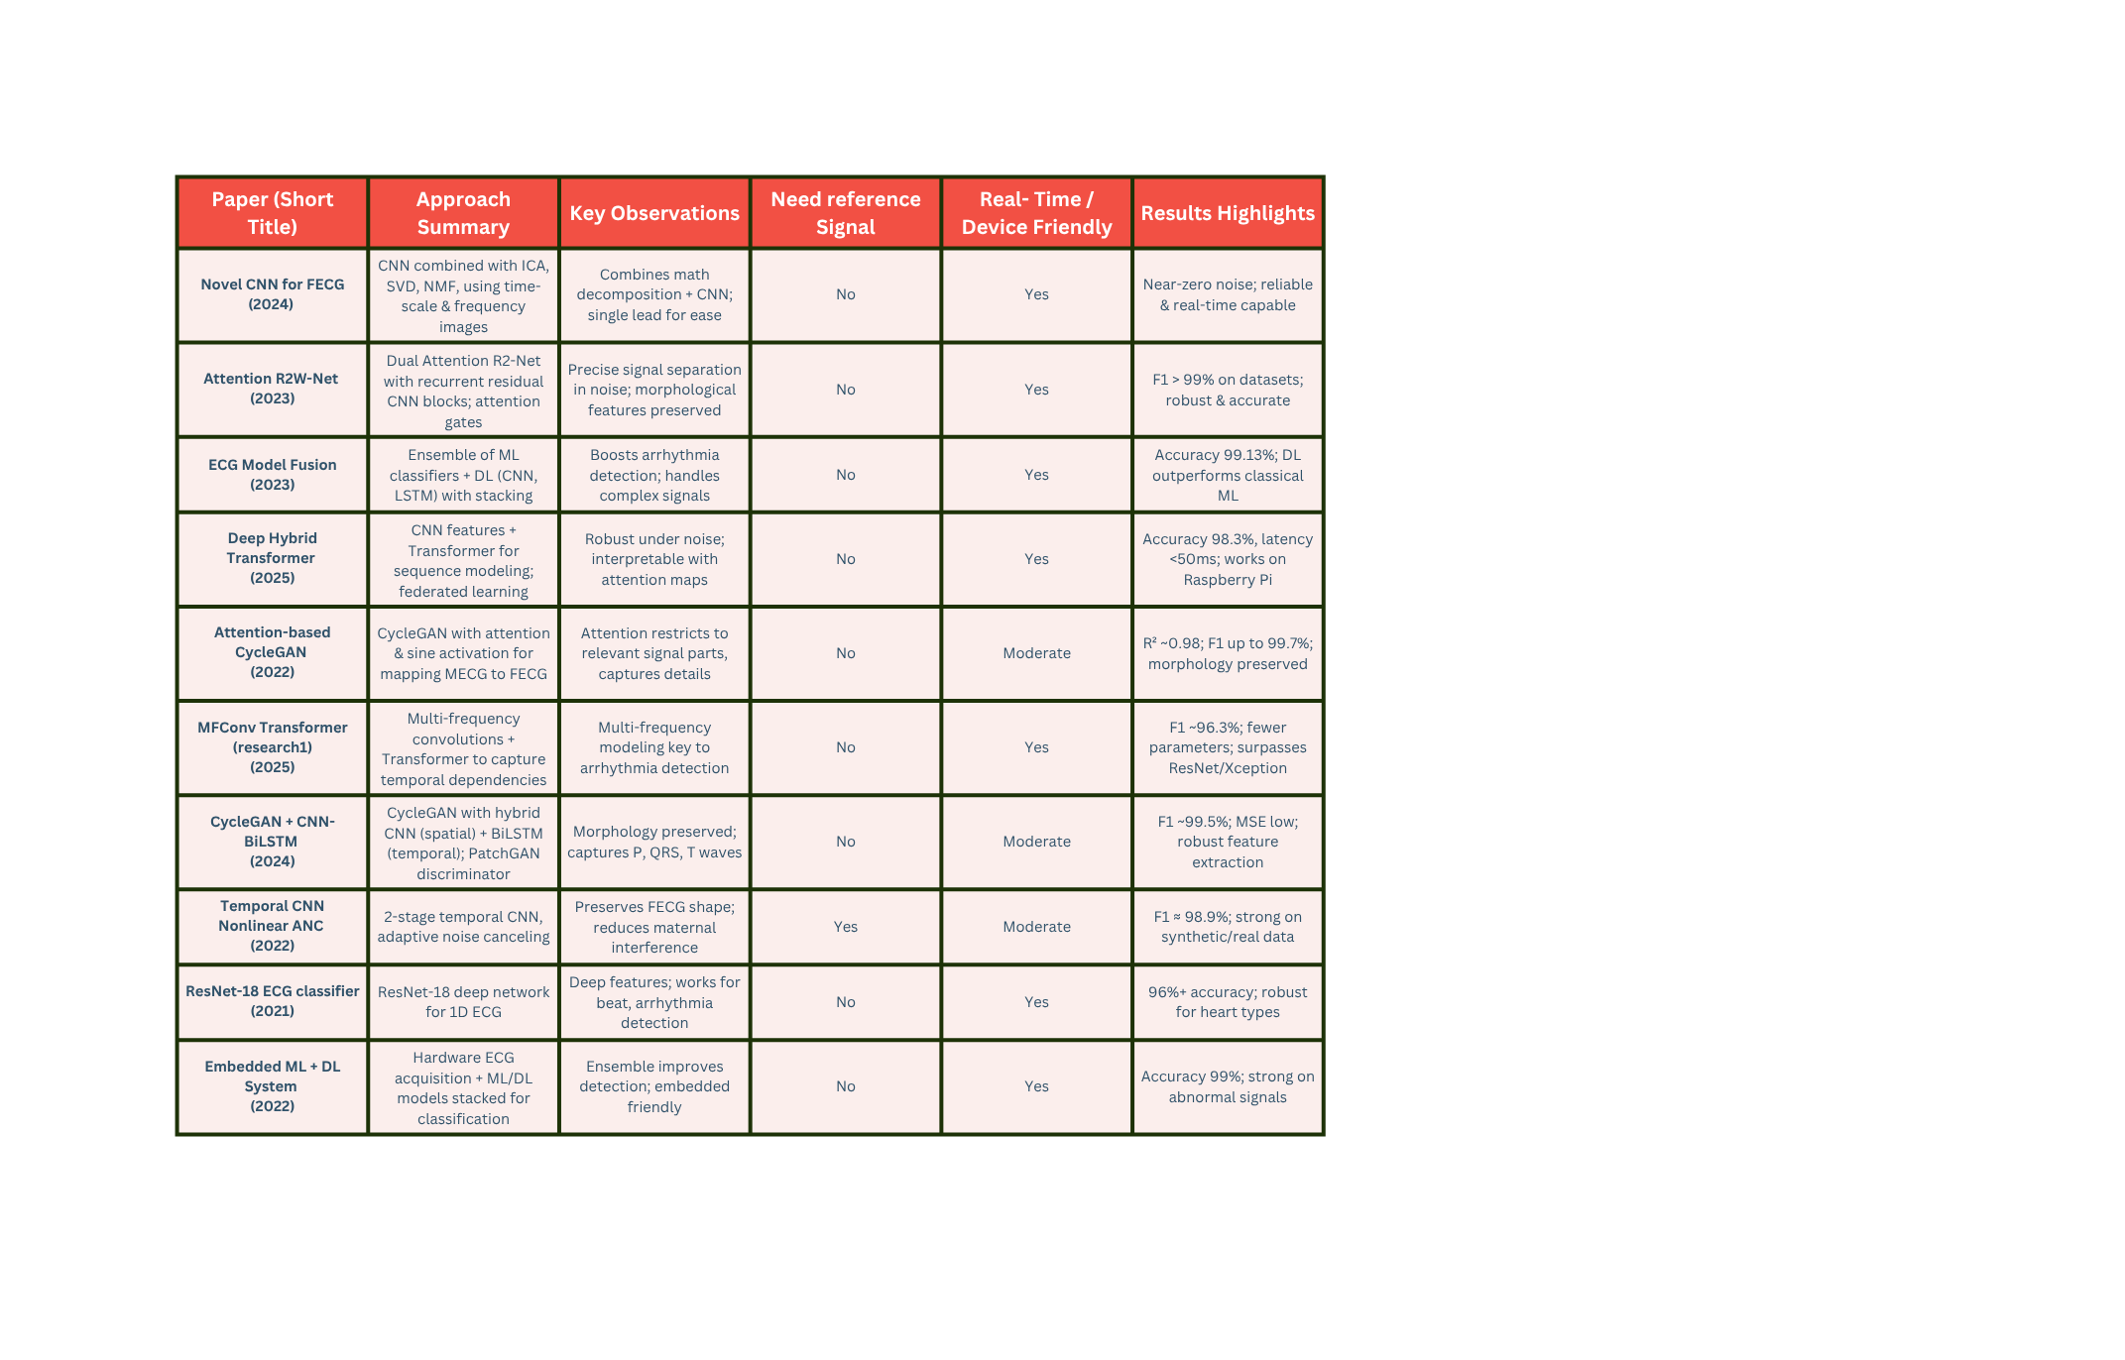
LITERATURE
SURVEY
DEPARTMENT OF ELECTRONICS AND COMMUNICATION ENGINEERING, BHAGWAN PARSHURAM INSTITUTE OF TECHNOLOGY

Slide 7
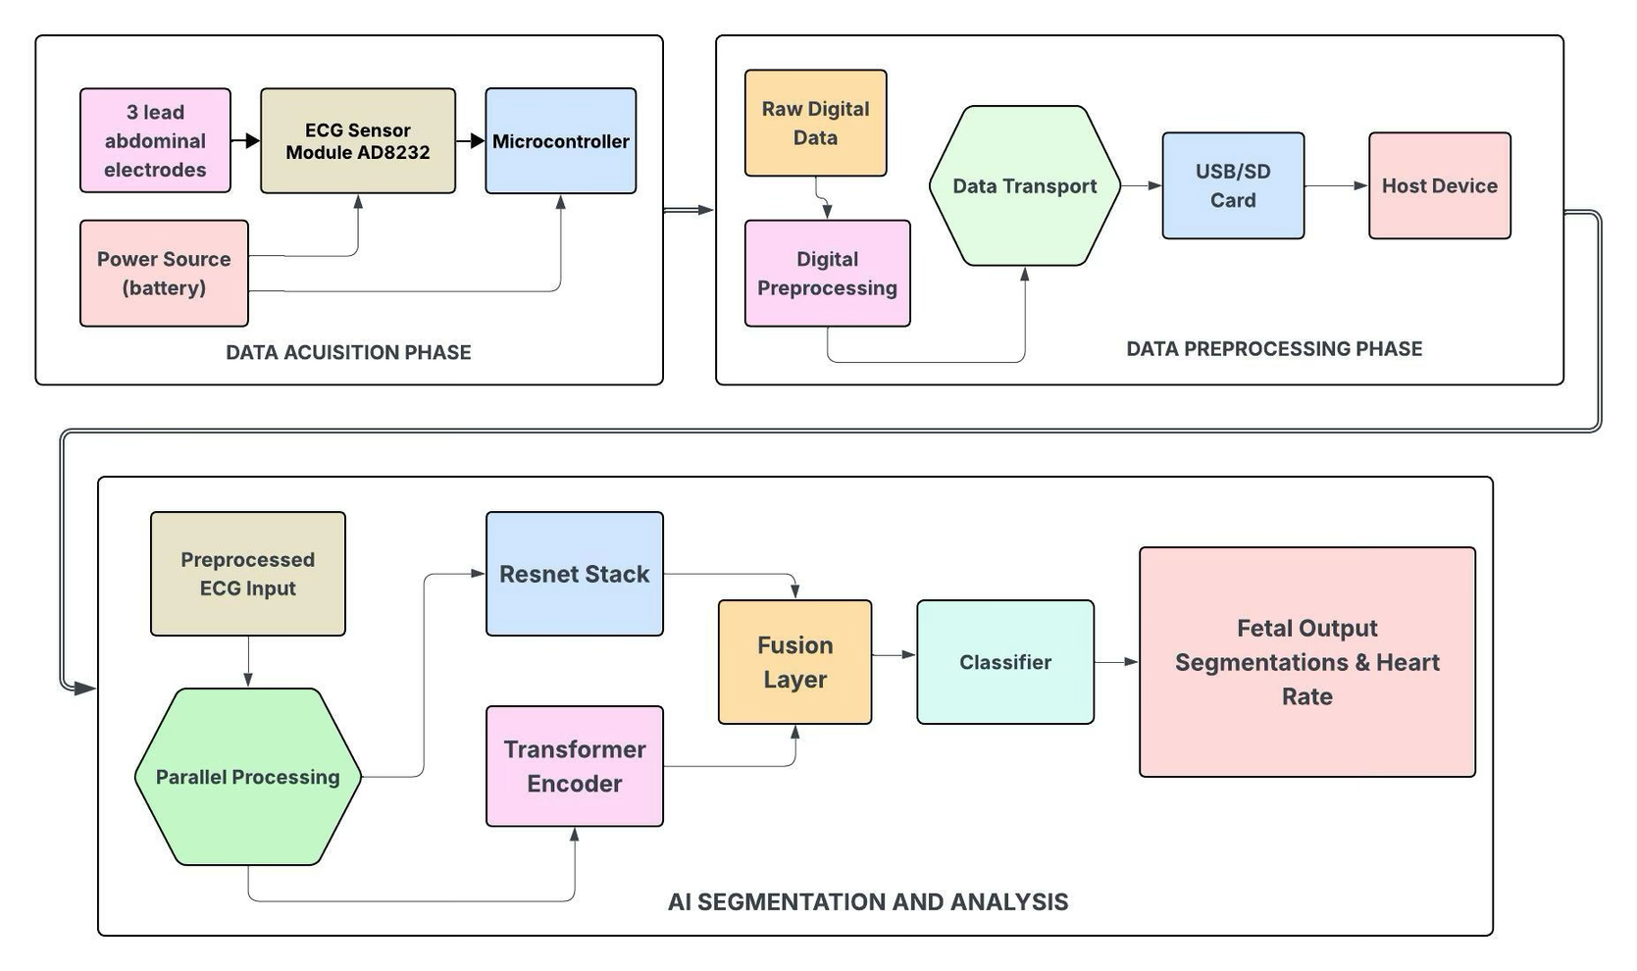
SOLUTION PRESENTED
DEPARTMENT OF ELECTRONICS AND COMMUNICATION ENGINEERING, BHAGWAN PARSHURAM INSTITUTE OF TECHNOLOGY

Slide 8
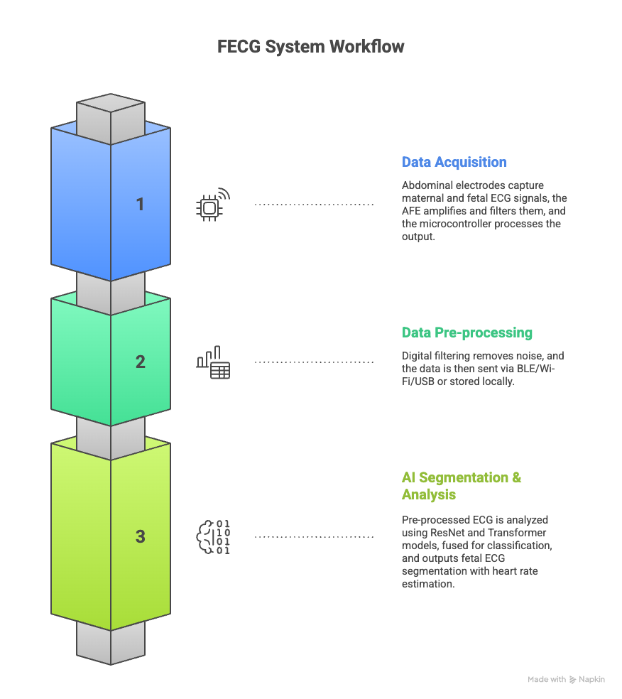
SOLUTION PRESENTED
Fetal ECG System Workflow:
Data Acquisition:
Abdominal electrodes capture maternal and fetal ECG signals
AFE module amplifies and filters the signals
Microcontroller receives the processed data
Data Pre-processing & Transfer:
Digital filtering and noise removal are applied
Data is transmitted via BLE, Wi-Fi, USB, or stored locally
AI Segmentation & Analysis:
Pre-processed ECG is analyzed by ResNet and Transformer models
Features are fused and classified
Final output includes fetal ECG segmentation and heart rate estimation.
DEPARTMENT OF ELECTRONICS AND COMMUNICATION ENGINEERING, BHAGWAN PARSHURAM INSTITUTE OF TECHNOLOGY

Slide 9
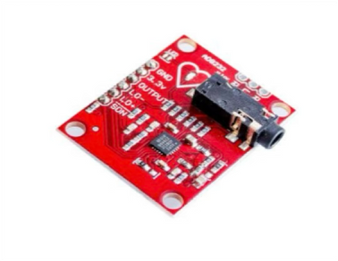
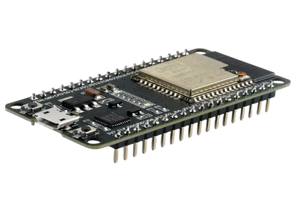
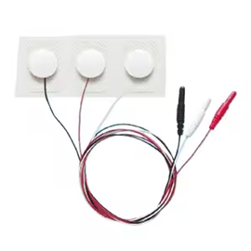
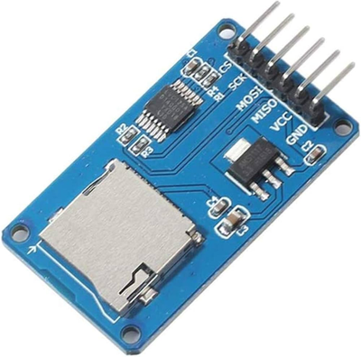
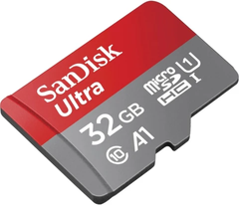
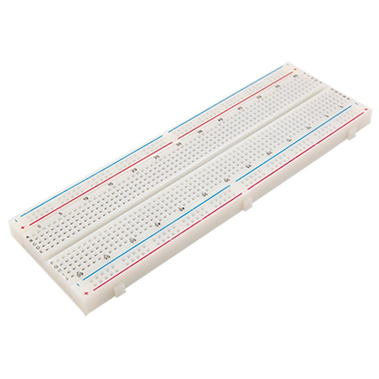
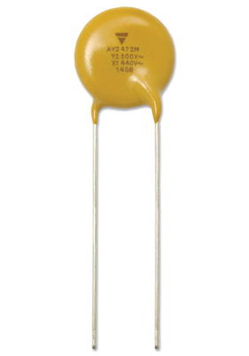
COMPONENTS OR SOFTWARE USED
Hardware Components :
AD8232 ECG Sensor Module
ESP32 Development Board (DOIT DevKit v1)
3-Lead Ag/AgCl ECG Electrodes
MicroSD Card Module (SPI Interface)
MicroSD Card (32GB, Class 10)
Micro-USB Cable
USB Power Adapter (5V/1A)
Breadboard (830-hole)
Jumper Wires (Male-to-Male & Male-to-Female)
Male Header Pins (40-pin)
Female Header Pins (40-pin)
Resistors (10kΩ, 1kΩ assortment)
Capacitors (0.1µF, 10µF assortment)
AD8232 ECG SENSOR
ESP32 DEVELOPMENT BOARD
3-LEAD AG/AGCL ECG ELECTRODES
MICROSD CARD WITH MODULE
BREADBOARD (830-HOLE)
RESISTORS AND CAPACITORS
DEPARTMENT OF ELECTRONICS AND COMMUNICATION ENGINEERING, BHAGWAN PARSHURAM INSTITUTE OF TECHNOLOGY

Slide 10










COMPONENTS OR SOFTWARE USED
Software Components :
Python
PyTorch or TensorFlow
Arduino IDE
Kaggle
Streamlit
Pandas & NumPy
Matplotlib & Seaborn
Scikit-learn
Git Hub
PYTHON
PYTORCH
ARDUINO IDE
VS CODE
STREAMLIT
NUMPY
SEABORN
SCIKIT LEARN
OPENCV
GIT
DEPARTMENT OF ELECTRONICS AND COMMUNICATION ENGINEERING, BHAGWAN PARSHURAM INSTITUTE OF TECHNOLOGY

Slide 11
WORKING OF PROJECT
PHASE 1
PHASE 2
DATA ACQUISITION & PREPROCESSING
MATERNAL-FETAL ECG SEPARATION
DATASET
PhysioNet Challenge 2013 (75 records, 4-channel abdominal ECG)
Sampling rate: 1000 Hz | Duration: 60 seconds/record
QRS annotations provided (.fqrs) files.
OBJECTIVE
Isolate pure fetal ECG from mixed maternal-fetal abdominal signals
CHALLENGE
Abdominal ECG contains superimposed maternal and fetal signals
Maternal heart rate: 60-100 bpm (dominant amplitude)
Fetal heart rate: 120-180 bpm (weaker amplitude)
Requires signal separation while preserving morphology
SIGNAL PRE-PROCESSING
Notch filter (50 Hz) → powerline noise removal
Bandpass filter (0.5-100 Hz) → frequency range extraction
Wavelet denoising (Symlet-10, Level 6) → artifact suppression
Baseline correction → drift elimination
APPROACH
Source separation techniques for multi-channel recordings
Frequency-based or blind source separation methods
Component identification based on physiological characteristics
Signal reconstruction maintaining cardiac waveform integrity
DATA ORGANIZATION AND OUTCOME
Batch processing: 25 samples/batch
Total: 4.5M preprocessed samples
Outcome: Clean 4-channel ECG signals ready for analysis
DEPARTMENT OF ELECTRONICS AND COMMUNICATION ENGINEERING, BHAGWAN PARSHURAM INSTITUTE OF TECHNOLOGY

Slide 12
PHASE 3
PHASE 4
MORPHOLOGICAL EXTRACTION
ARRHYTHMIA CLASSIFICATION
ARCHITECTURE: Hybrid Deep Learning Model
ResNet Blocks: Spatial feature extraction with skip connections
Multi-Frequency CNN: Parallel kernels for multi-scale pattern capture​. Small kernels → QRS, Medium → T-wave, Large → P-wave
Transformer Attention: Multi-head attention (4 heads) for P-QRS-T dependencies
U-Net Decoder: Upsampling with skip connections for pixel-wise segmentation
Output Classes: Class 0: Background
Class 1: QRS
Class 2: T-wave
Performance: IoU: 85%
T-wave accuracy: 90%
Boundary precision: ±15ms
Outcome: Precise P-QRS-T segmentation for morphological analysis
FEATURE EXTRACTION
Heart rate, R-R intervals, HRV
QRS duration, amplitude
T-wave duration, amplitude
QT interval, ST segment deviation
QRS-T ratio, Corrected QT (QTc)
CLINICAL CRITERIA & CLASSIFICATION
Long QT: >440ms | Short QT: <360ms
Bradycardia: HR <110 bpm | Tachycardia: HR >180 bpm
ST elevation: >0.1 mV | Irregular rhythm via HRV
Algorithm: Ensemble machine learning methods
Input: 15+ morphological features
Output: Binary (Normal / Arrhythmic) + confidence score
OUTCOME & PERFORMANCES
Accuracy: 92% | Sensitivity: 95% | Specificity: 90% | AUC: 0.94
Validated arrhythmia detection system for clinical deployment
DEPARTMENT OF ELECTRONICS AND COMMUNICATION ENGINEERING, BHAGWAN PARSHURAM INSTITUTE OF TECHNOLOGY

Slide 13
COMPARISON WITH EXISTING SOLUTIONS
Feature | Existing Solutions | Our Proposed Solution (Hybrid)
Analysis Engine | Monolithic Models: Often use a single U-Net (CNN) or a standard RNN/Transformer | Dual-Path Fused Model: 1. ResNet Path (Local Expert) 2. Multi-Frequency Transformer Path (Global Expert)
Feature Extraction | Local or Global: • U-Nets are strong at local waveform shape but miss long-range rhythm patterns. • RNNs are good at global time-series but weak on fine-grained signal morphology. | Synergistic (Local + Global): • ResNet Path captures the precise, fine-grained morphology (shape) of the P-QRS-T waves. • Transformer Path models the global, long-range dependencies and rhythm of the entire signal.
Noise Handling | Single-Scale Analysis: Standard models process the signal as a whole, making them vulnerable to noise across different frequencies (e.g., maternal muscle noise, baseline wander). | Multi-Frequency Analysis:Our Convolutional Transformer processes the signal at multiple frequencies simultaneously, allowing it to isolate the weak fetal signal from complex, multi-band noise.
Output | Primarily Fetal Heart Rate (FHR) estimation. Waveform segmentation is often less accurate. | High-Fidelity Segmentation Mask: Provides a precise, sample-by-sample segmentation of the fetal ECG, leading to more accurate heart rate estimation and morphological insights.
DEPARTMENT OF ELECTRONICS AND COMMUNICATION ENGINEERING, BHAGWAN PARSHURAM INSTITUTE OF TECHNOLOGY

Slide 14
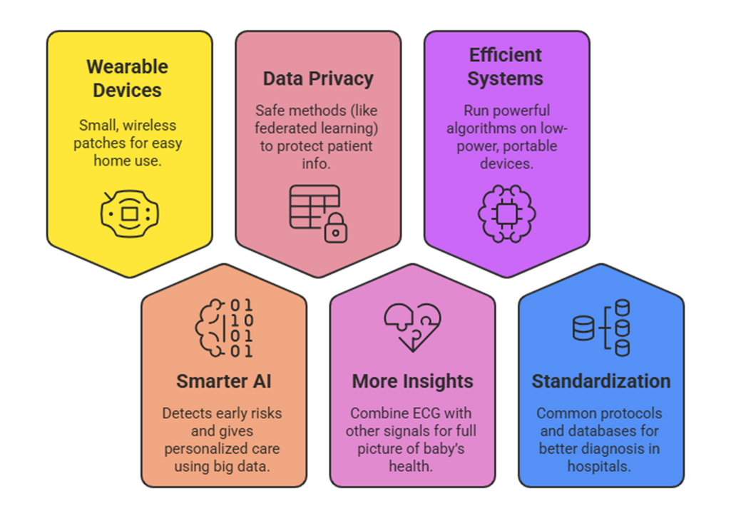
FUTURE SCOPE
1
Wearable Devices – Small, wireless patches for easy home use.
2
Smarter AI – Detects early risks and gives personalized care using big data.
3
Data Privacy – Safe methods (like federated learning) to protect patient info.
4
More Insights – Combine ECG with other signals for full picture of baby’s health.
5
Efficient Systems – Run powerful algorithms on low-power, portable devices.
6
Standardization – Common protocols and databases for better diagnosis in hospitals
DEPARTMENT OF ELECTRONICS AND COMMUNICATION ENGINEERING, BHAGWAN PARSHURAM INSTITUTE OF TECHNOLOGY

Slide 15
REFERENCES
D. S. S. Chintapenta, A. Verma, and S. Majumder, “MFCONVTR: Multi-frequency Convolutional Transformer for Fetal Arrhythmia Detection in non-invasive FECG,” in Lecture notes in computer science, 2025, pp. 49–59. doi: 10.1007/978-3-031-87660-8_4
S. Cao, H. Xiao, G. Gong, W. Fang, and C. Chen, “Morphology extraction of fetal ECG using temporal CNN-based nonlinear adaptive noise cancelling,” PLoS ONE, vol. 17, no. 12, p. e0278917, Dec. 2022, doi: 10.1371/journal.pone.0278917.
E. Jing, H. Zhang, Z. Li, Y. Liu, Z. Ji, and I. Ganchev, “ECG heartbeat classification based on an improved RESNET-18 model,” Computational and Mathematical Methods in Medicine, vol. 2021, pp. 1–13, Apr. 2021, doi: 10.1155/2021/6649970
Mohebbian, M. R., Vedaei, S. S., Wahid, K. A., Dinh, A., Marateb, H. R., & Tavakolian, K. (2021). Fetal ECG extraction from maternal ECG using Attention-Based CycleGAN. IEEE Journal of Biomedical and Health Informatics, 26(2), 515–526.
L. Chen, S. Wu, and Z. Zhou, “Fetal ECG Signal Extraction from Maternal Abdominal ECG Signals Using Attention R2W-Net,” Sensors, vol. 25, no. 3, p. 601, Jan. 2025, doi: 10.3390/s25030601.
DEPARTMENT OF ELECTRONICS AND COMMUNICATION ENGINEERING, BHAGWAN PARSHURAM INSTITUTE OF TECHNOLOGY

Slide 16
Y. Yang, L. Chen, and S. Wu, “Enhancing Fetal Electrocardiogram Signal Extraction Accuracy through a CycleGAN Utilizing Combined CNN–BiLSTM Architecture,” Sensors, vol. 24, no. 9, p. 2948, May 2024, doi: 10.3390/s24092948.
M. Alghieth, “DeepECG-Net: a hybrid transformer-based deep learning model for real-time ECG anomaly detection,” Scientific Reports, vol. 15, no. 1, Jul. 2025, doi: 10.1038/s41598-025-07781-1
S. Ziani, “A Novel Approach for Detecting Fetal Electrocardiogram (FECG) Signals: Integration of Convolutional Neural Network (CNN) with Advanced Mathematical Techniques,” in Lecture notes in networks and systems, 2024, pp. 402–410. doi: 10.1007/978-3-031-53824-7_37.
DEPARTMENT OF ELECTRONICS AND COMMUNICATION ENGINEERING, BHAGWAN PARSHURAM INSTITUTE OF TECHNOLOGY

Slide 17


THANK YOU
DEPARTMENT OF ELECTRONICS AND COMMUNICATION ENGINEERING, BHAGWAN PARSHURAM INSTITUTE OF TECHNOLOGY

